Slide 1
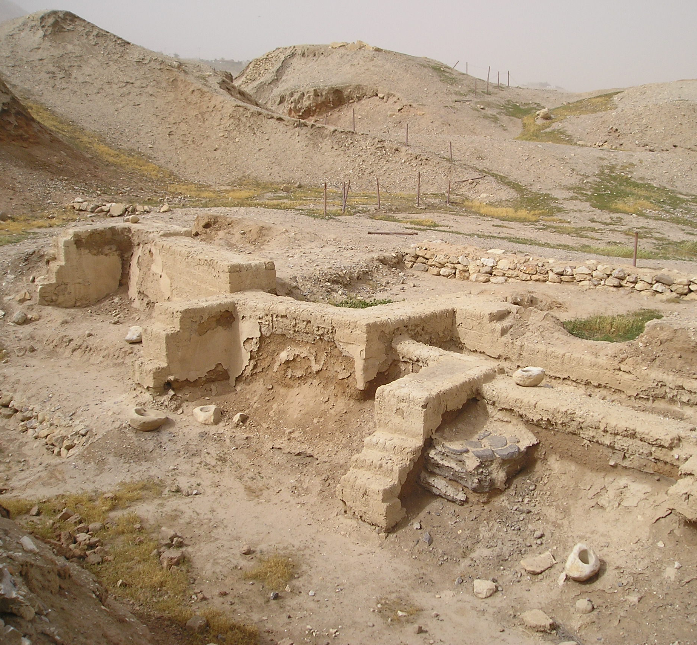
Proof that the Bible is the Word of God!
Part 2 – External Considerations

Slide 2
Proof that the Bible is the Word of God!
Introduction
The Bible is being attacked
“Sometime between the beginning of the eighteenth century and the end of the nineteenth, God died, though theology could not arrange a formal burial until the 1960’s” – Sociology for a New Day, 1974

Slide 3
Proof that the Bible is the Word of God!
Introduction
“Geological, anthropological, and archaeological study make it impossible for thinking men to take seriously the Biblical view of the universe and stories of creation in Genesis” – Encyclopedia Americana, 1968
Defenders of the faith must begin a vigorous counter-attack
Fiction repeated often enough becomes fact in the public mind

Slide 4
Proof that the Bible is the Word of God!
Introduction
The purpose of this study is to present simple proof that the Bible is indeed the absolute and immutable word of God
External Considerations
Internal Evidences
God

Slide 5
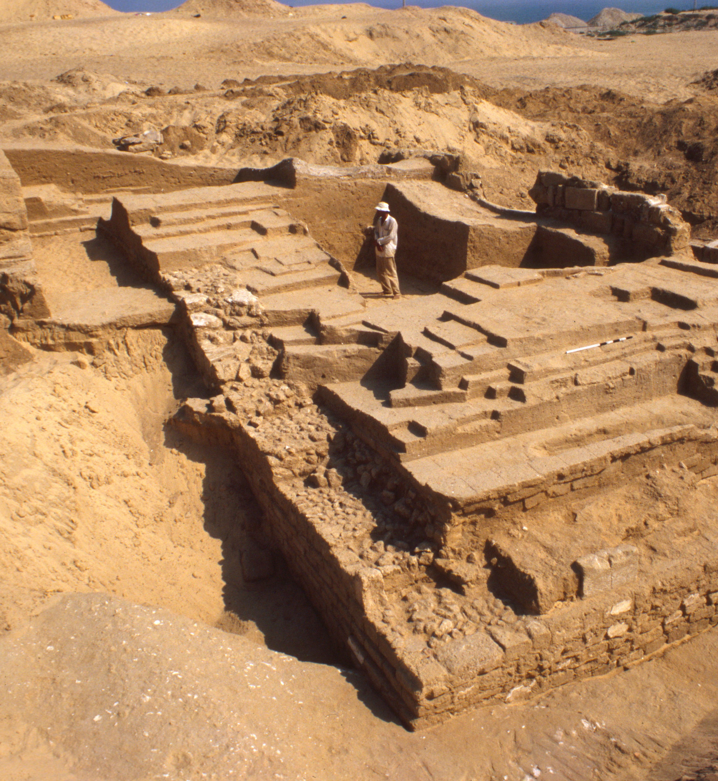
Proof that the Bible is the Word of God!
External Considerations – Archaeology
Archaeology
Cannot prove by itself that the Bible is the Word of God
It can provide evidence that either supports or refutes the claim that it is the Word of God
Archaeology provides evidence that does point to the Divine authorship of the Bible
Thousands of examples
Jericho and Nineveh

Slide 6
Proof that the Bible is the Word of God!
External Considerations – Archaeology
Joshua and the battle of Jericho can be found in Joshua chapter 6 of the Bible
The Israelites marched around the city once a day for six days
Marched around it seven times on the seventh day
The priests blew the trumpet, the people shouted, and the walls fell down flat
Then they burned the city with fire

Slide 7
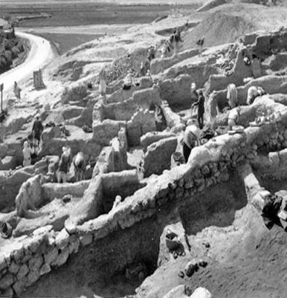
Proof that the Bible is the Word of God!
External Considerations – Archaeology
Dr. John Garstang found evidence that the city had been destroyed about 1400 B.C. (this corresponds with the Biblical date)
Double walls linked together by houses (corresponds to Rahab’s “house on the wall”)
The walls did fall down flat – something like an earthquake
3 foot ash layer shows that the city had been burnt with fire
Extra resource – Jericho Unearthed DVD

Slide 8
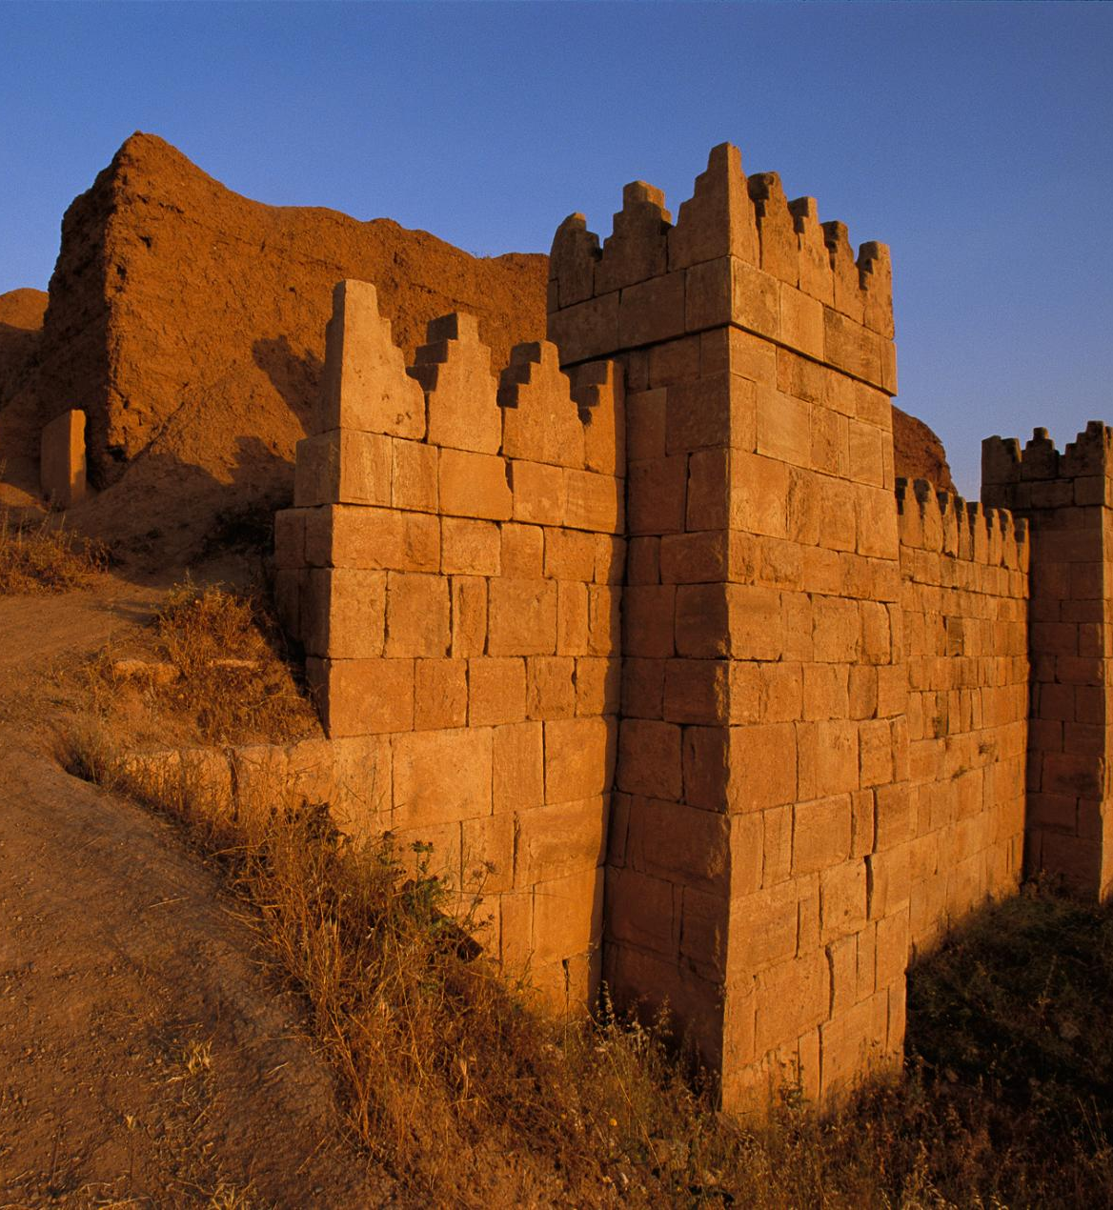
Proof that the Bible is the Word of God!
External Considerations – Archaeology
Nineveh
Famous from the Biblical account of Jonah
“An exceedingly great city, a three days walk” (Jonah 3:3)
Many scholars had come to think that the Biblical references to it were mythical

Slide 9
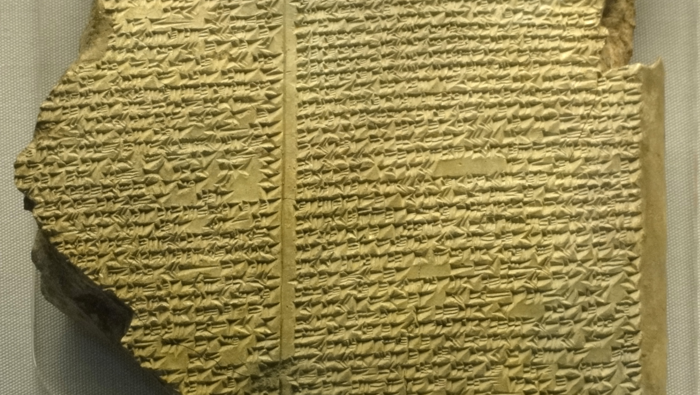
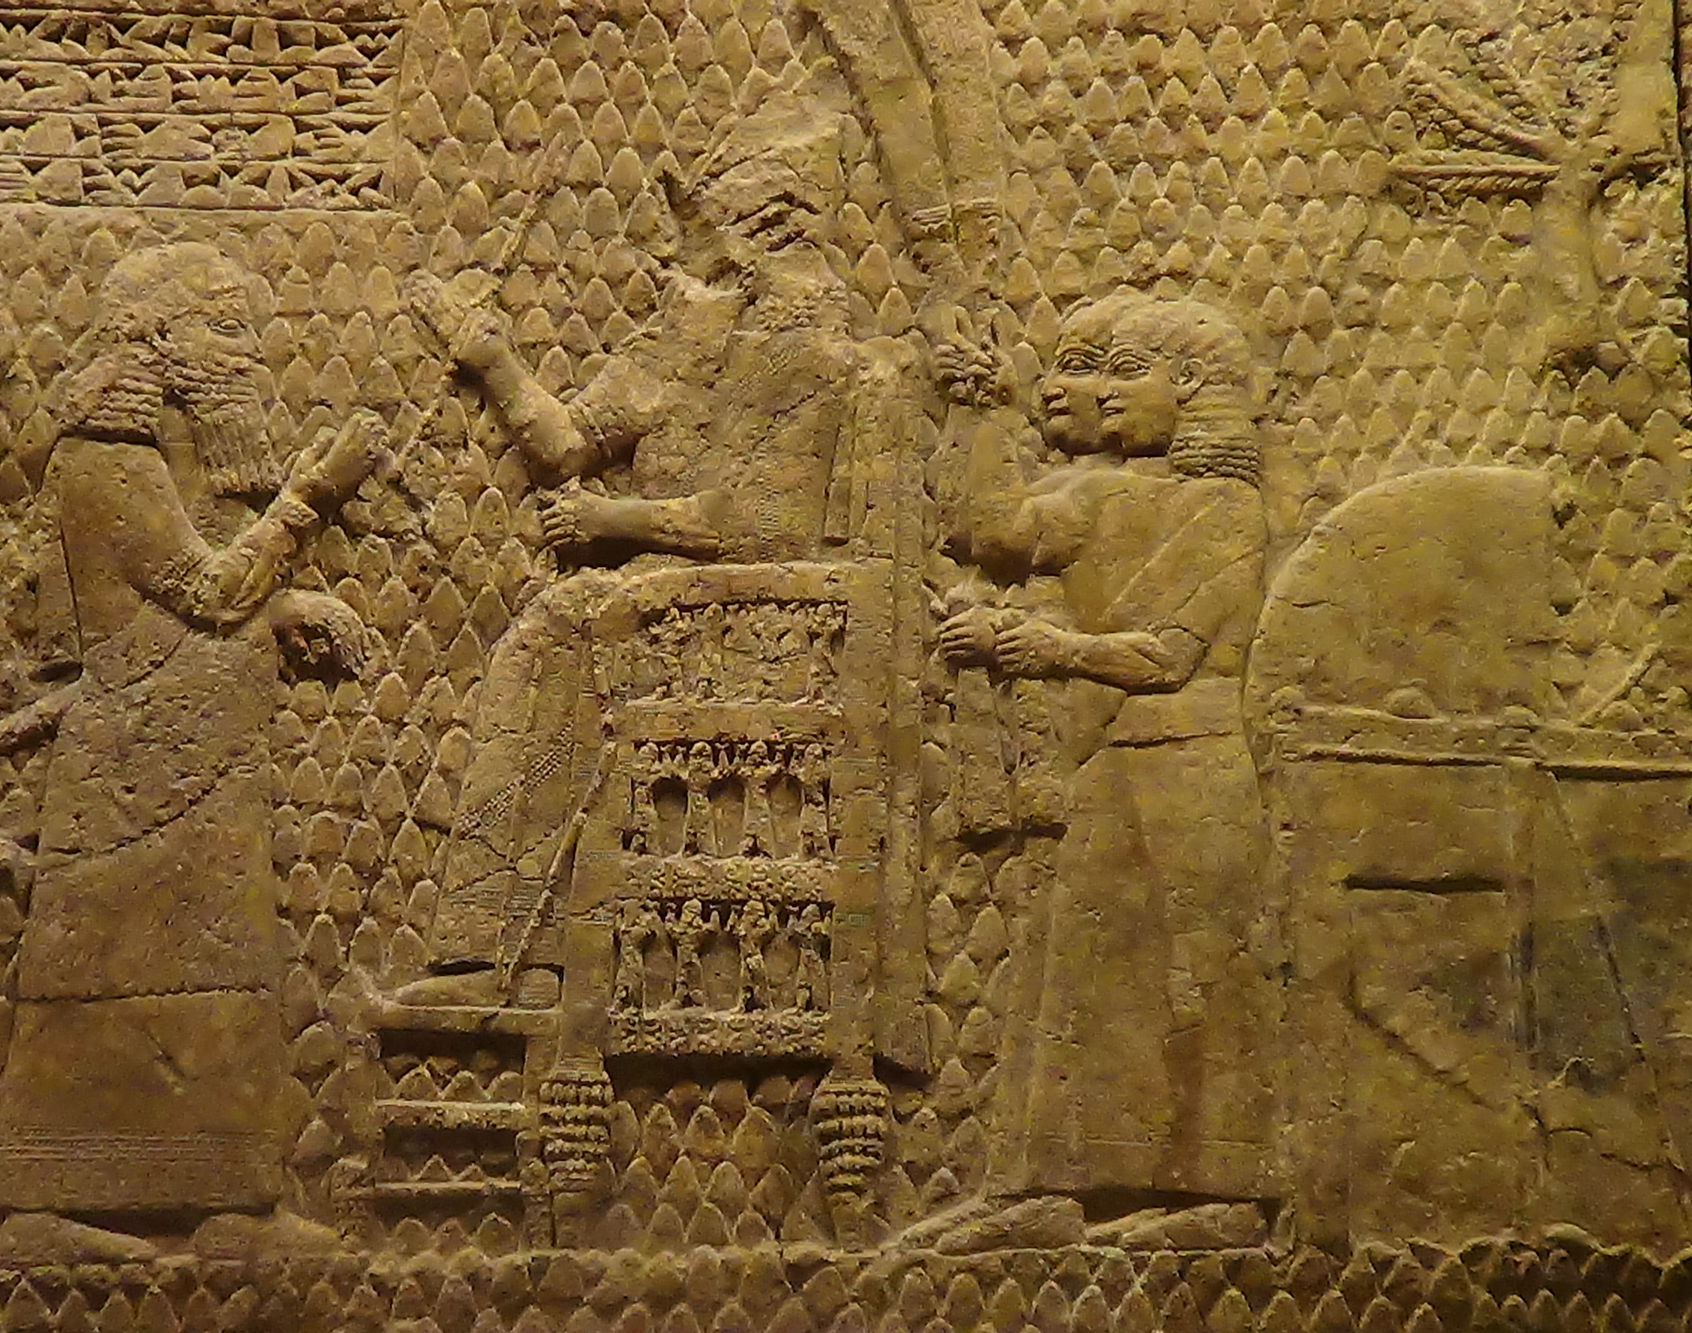
Proof that the Bible is the Word of God!
External Considerations – Archaeology
In 1847, Sir Austen Henry Layard explored the ruins of Nineveh
He found the lost palace of Sennacherib
He found the library of Ashurbanipal with over 22,000 cuneiform tablets
The second largest mound is called “Nebi Yunus” meaning “Prophet Jonah”

Slide 10
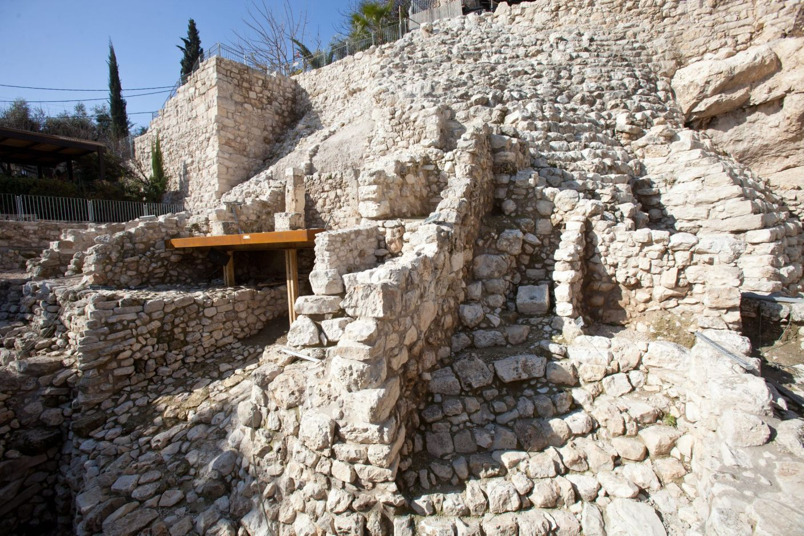
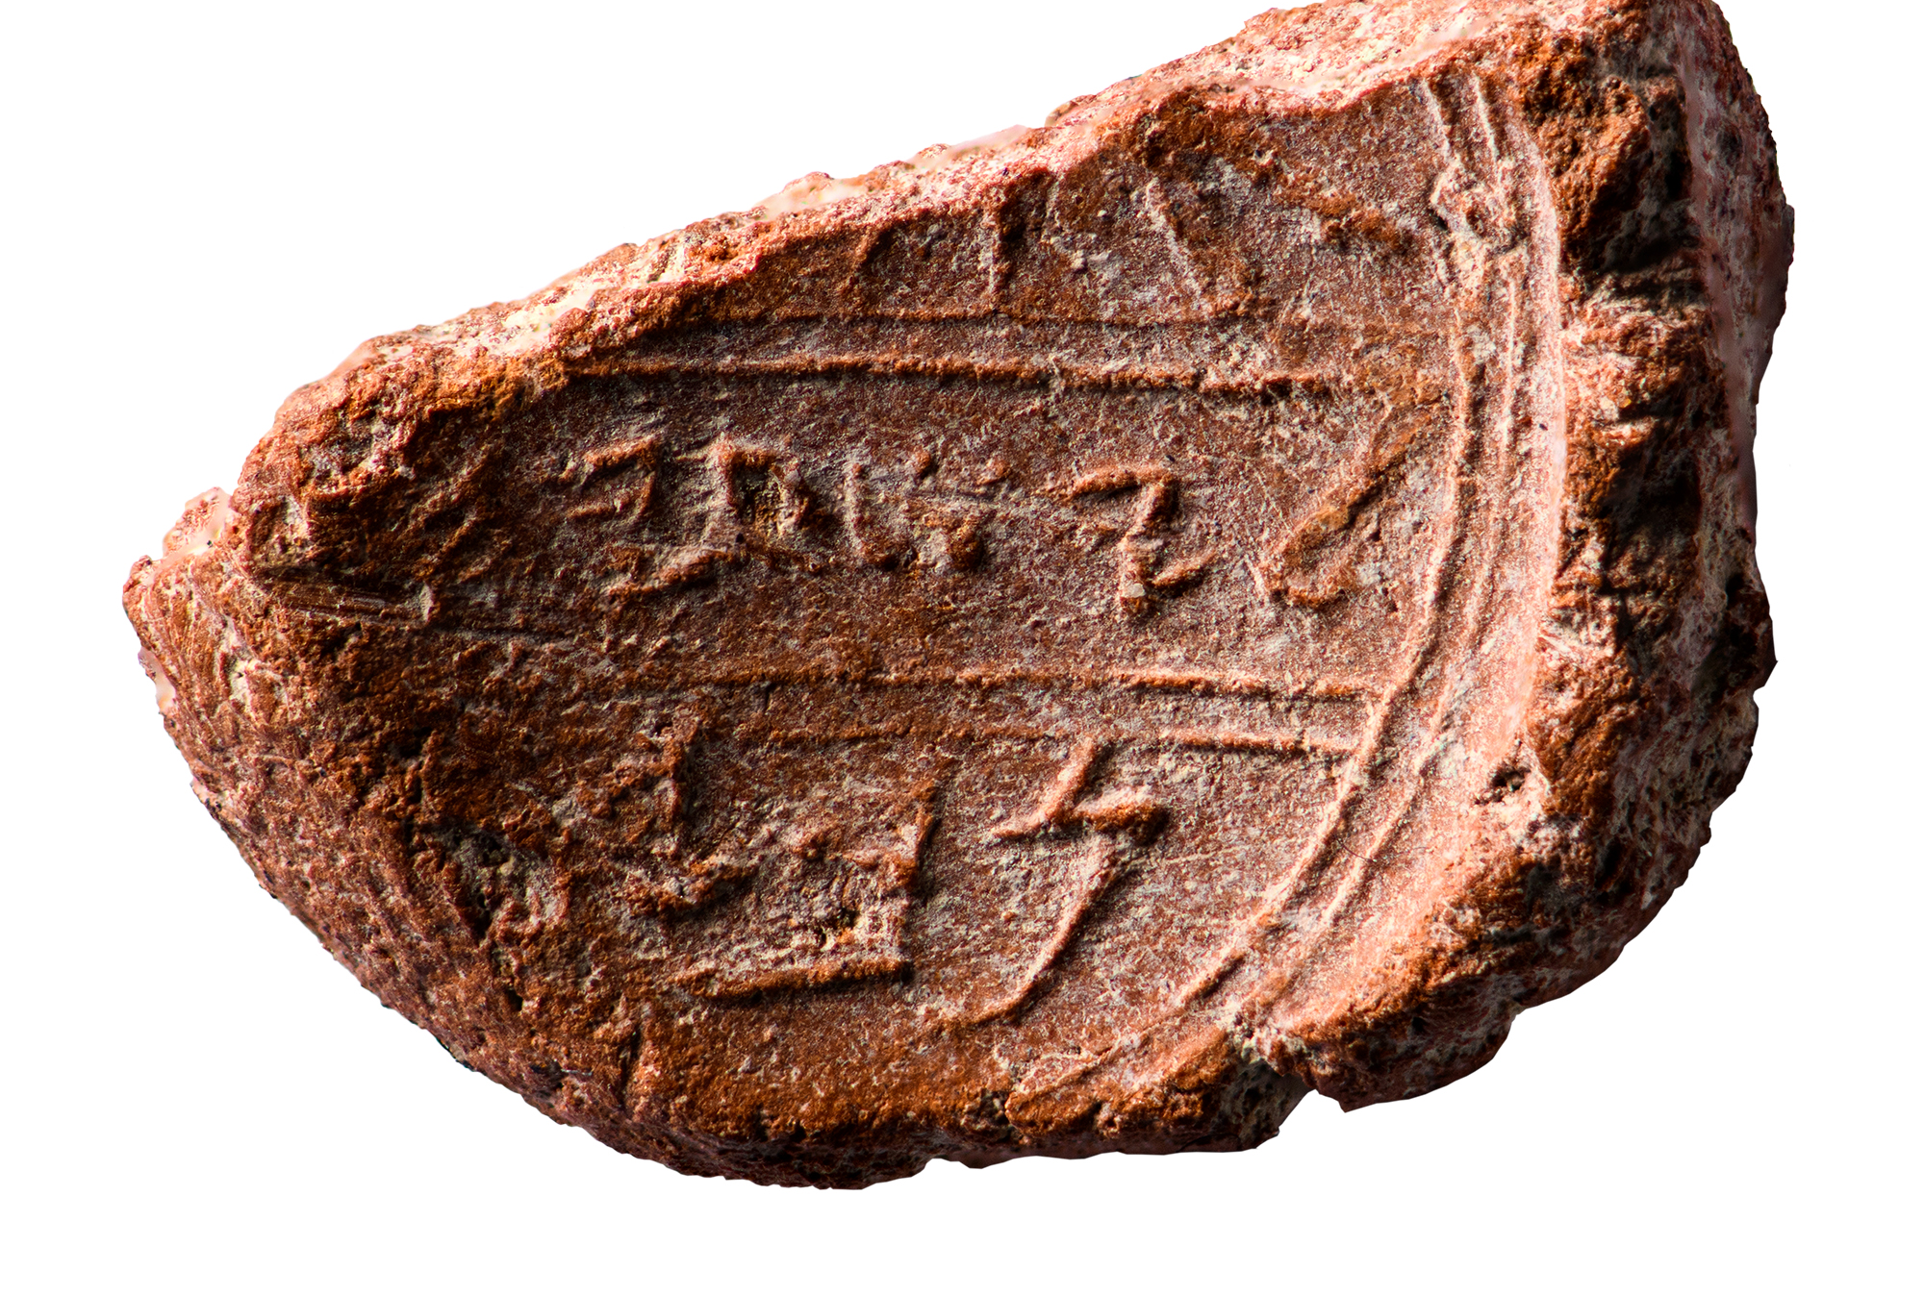
Proof that the Bible is the Word of God!
King David’s Palace
External Considerations – Archaeology
Both Jericho and Nineveh show how archaeology confirms the Biblical record
The Bible’s accuracy makes it a continuing guide to major archaeological finds in the Middle East
The external consideration of archaeology establishes the accuracy of the Scriptures and lends weight to its divine inspiration
Isaiah bulla
(official seal)

Slide 11
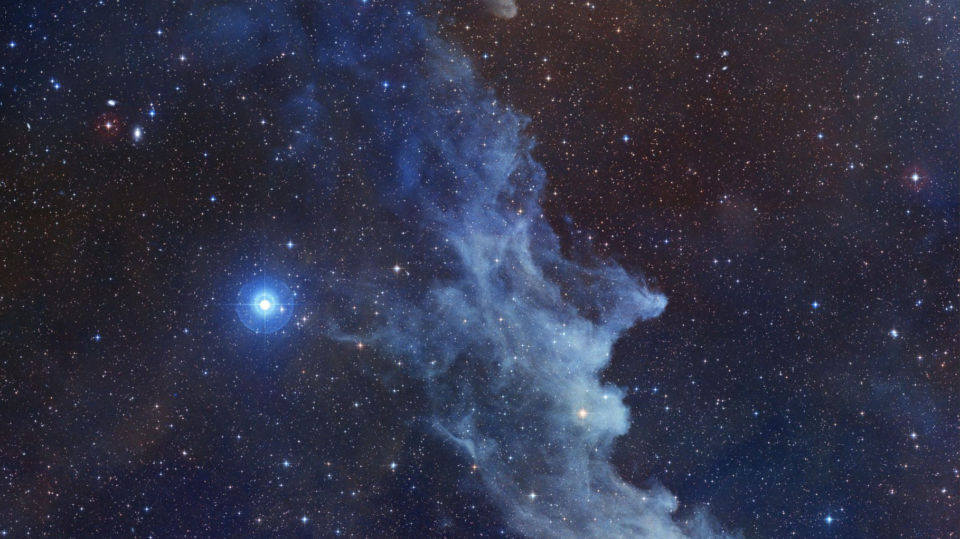
Proof that the Bible is the Word of God!
External Considerations – Creation
Widespread belief in evolution is primary cause of unbelief in the Bible
Evolutionary worldview
Life on earth has come to present state through millions of years of progression from lower life forms
Biblical worldview
The earth and its life forms were created in six days some 6000 years ago – see Genesis 1:5, Exodus 20:11, Mark 10:6

Slide 12
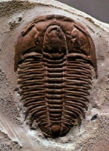
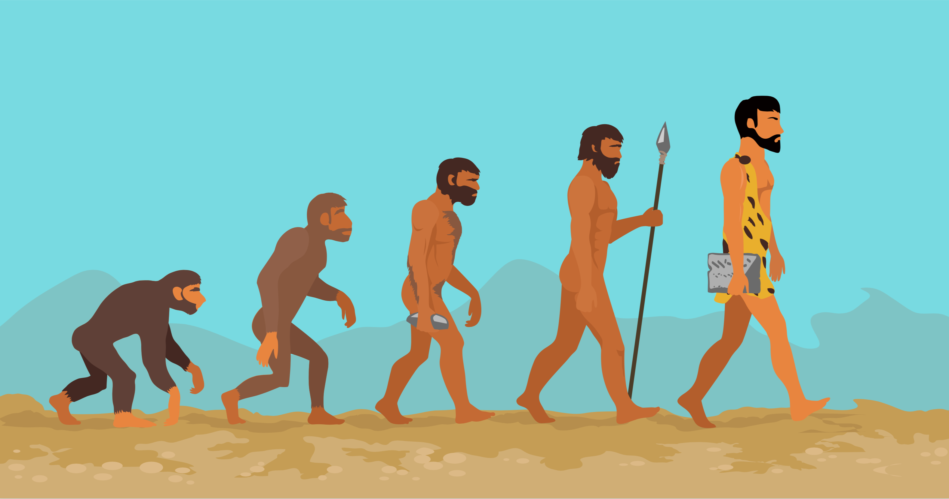
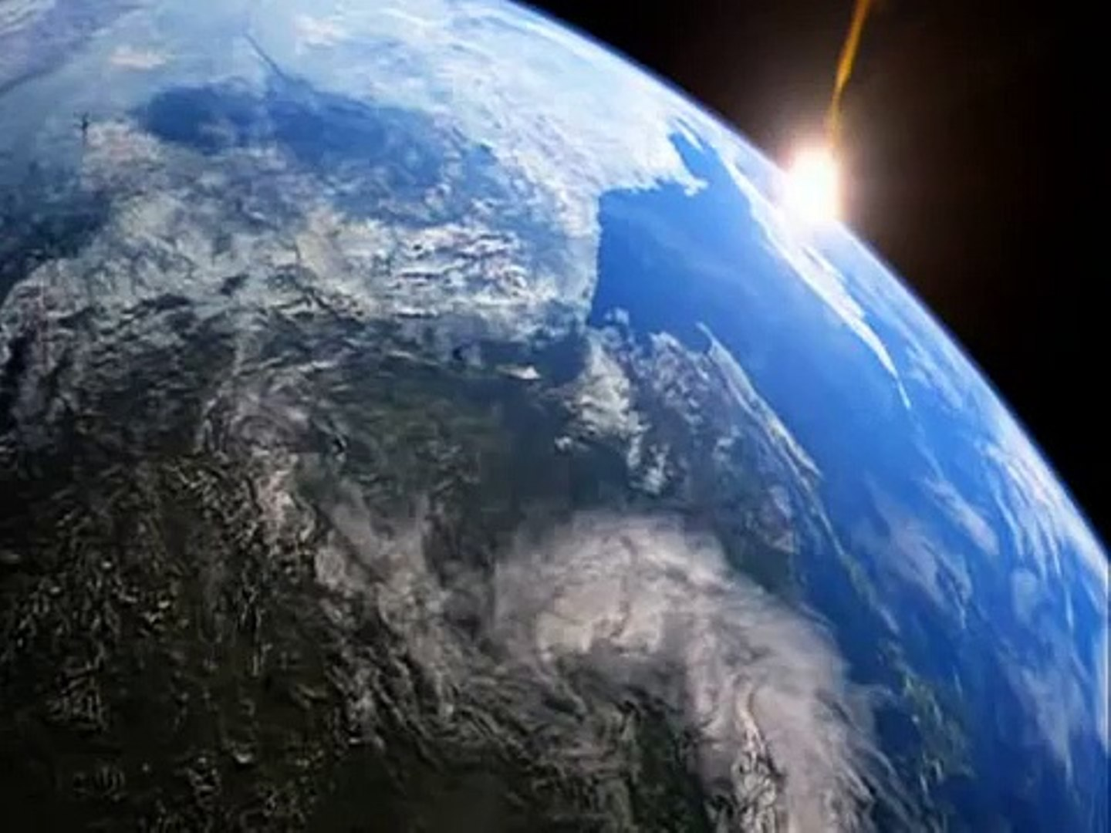
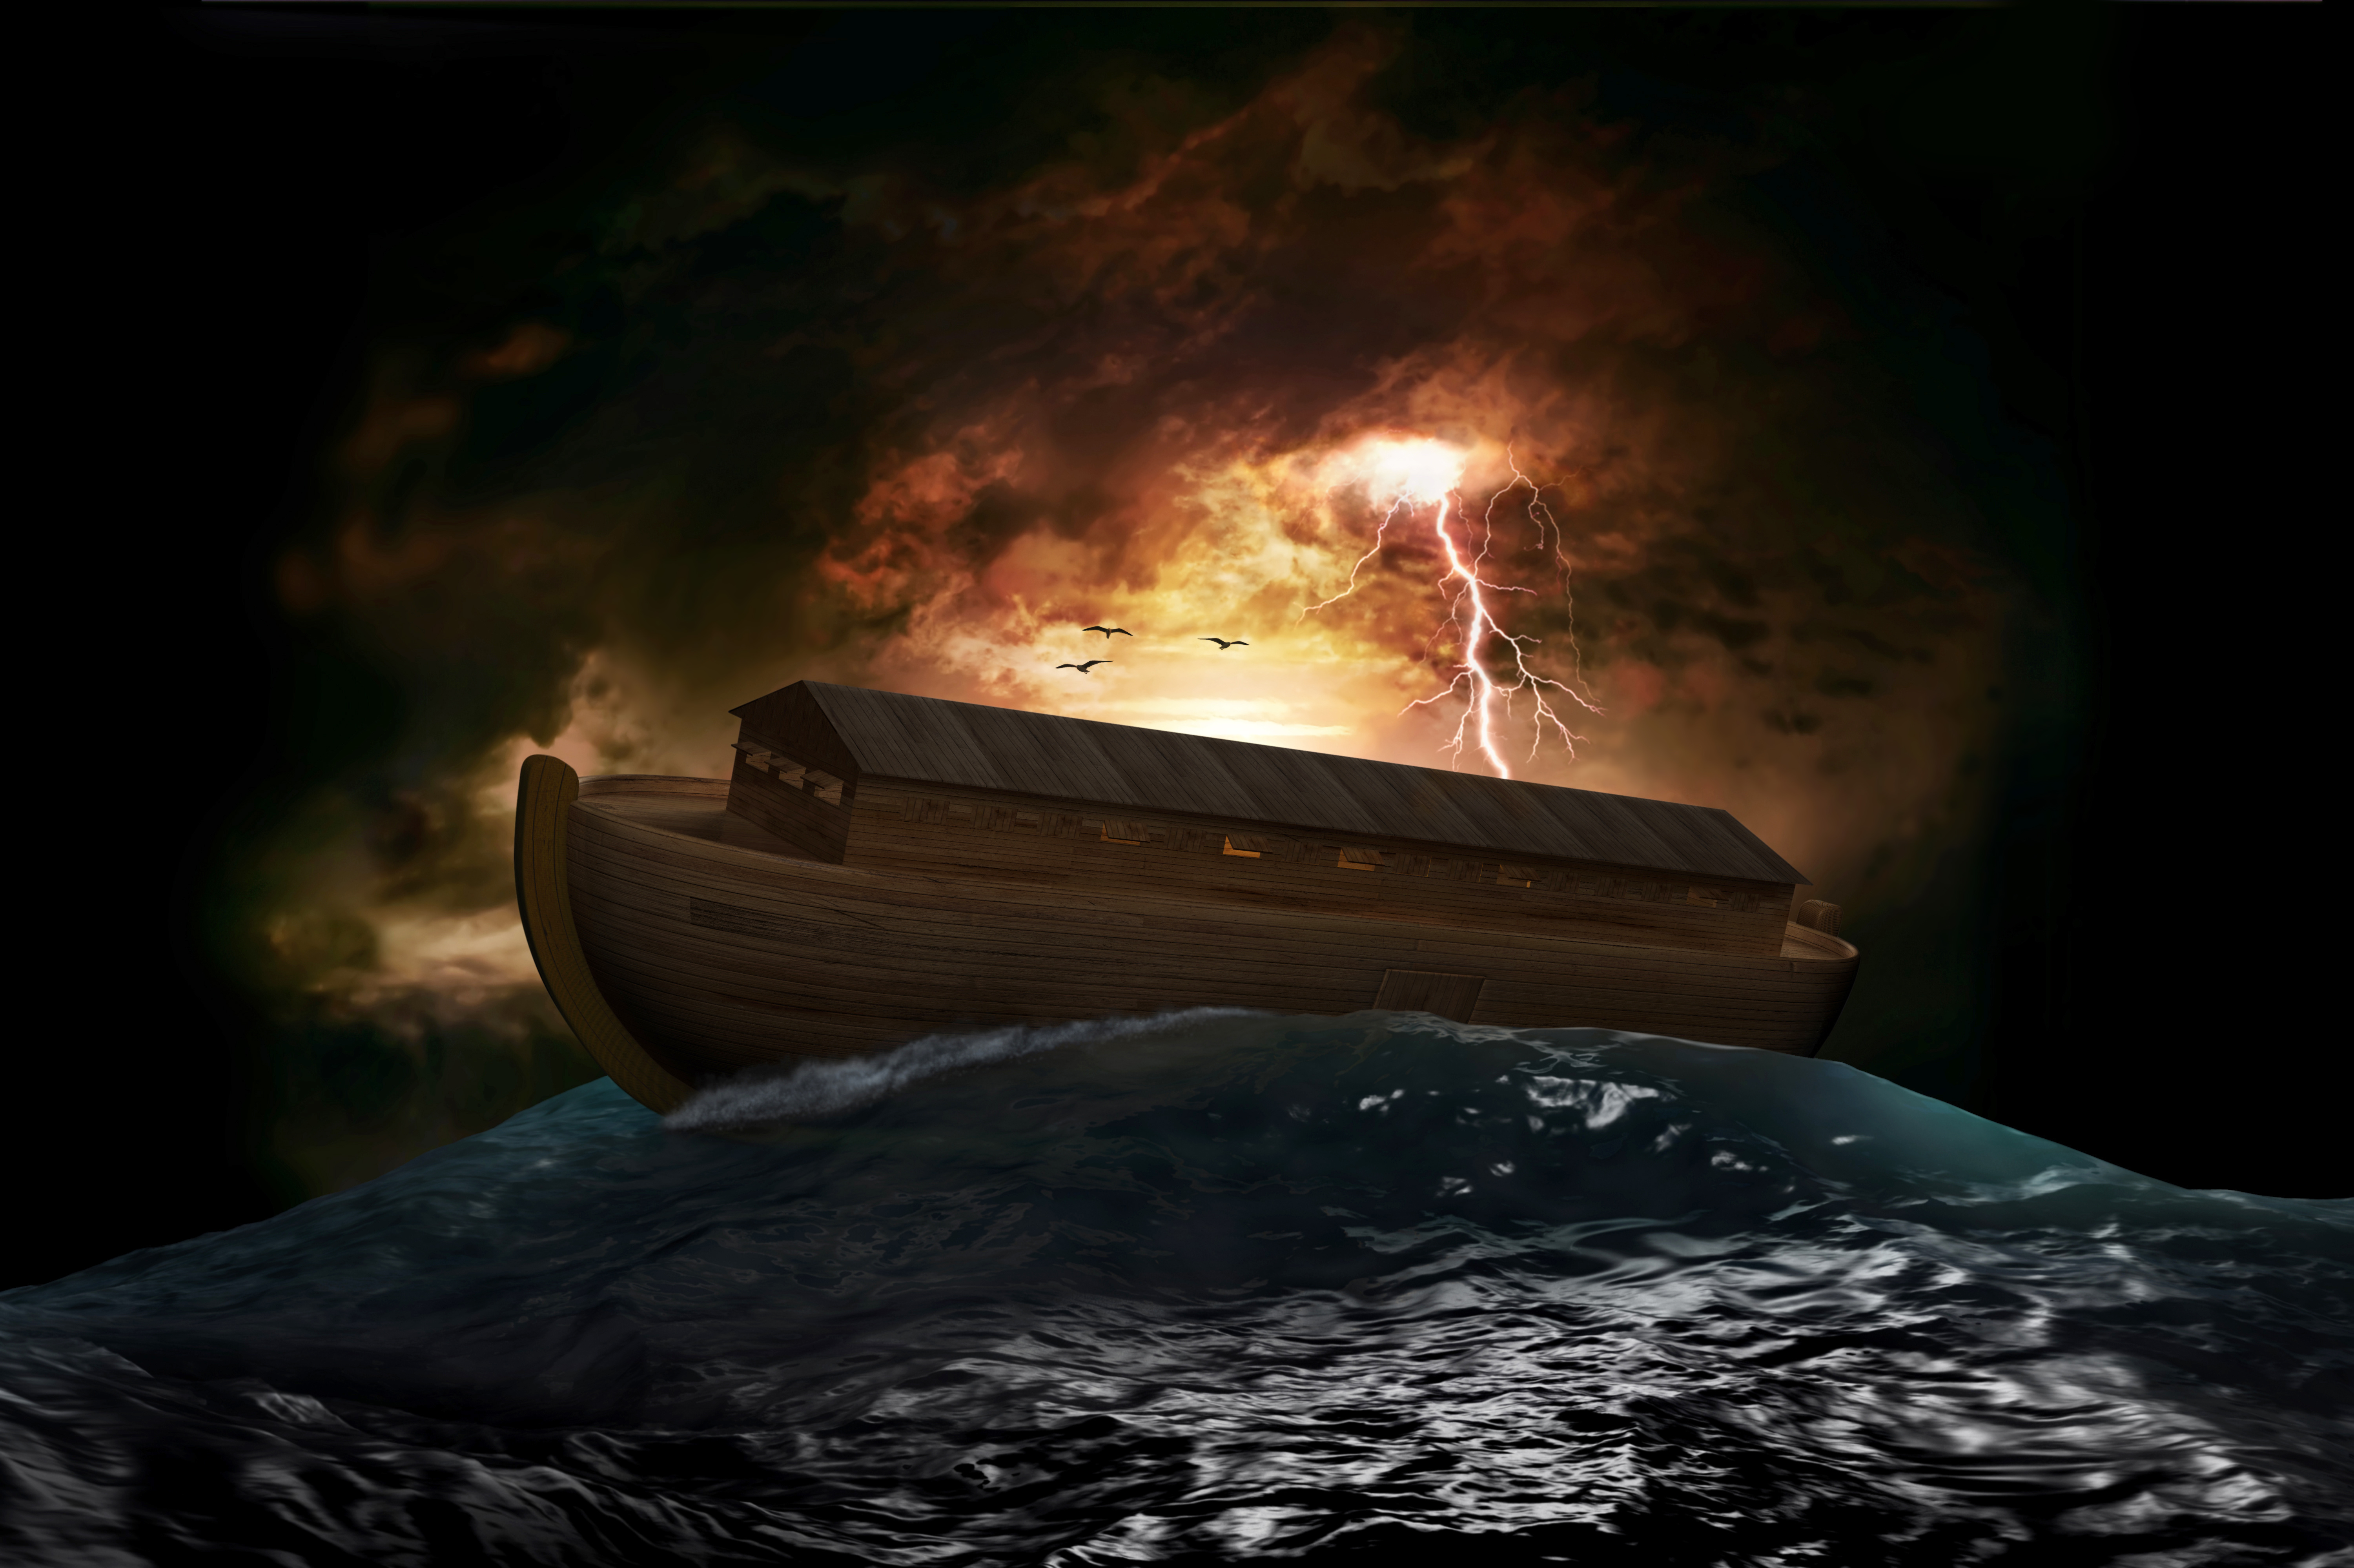
Proof that the Bible is the Word of God! External Considerations -- Creation
last trilobites
last dinosaurs
man
present
earth
first life
Evolution timeline
4 billion
1 billion
300 million
60 million
1 million
0
Creation
Noah’s Flood
Jesus
present
Creation timeline
6000
4500
2000
0

Slide 13
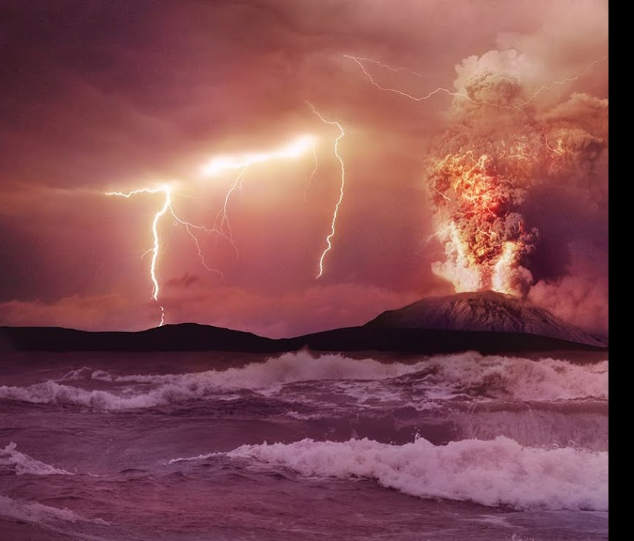
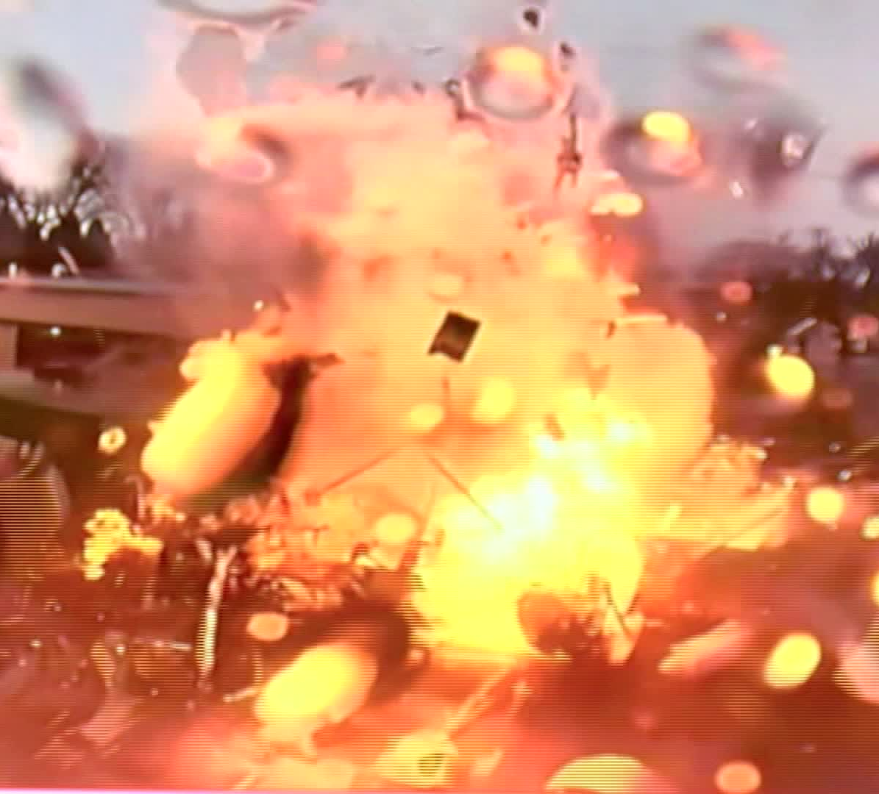
Proof that the Bible is the Word of God!
External Considerations – Creation
3 basic questions for evolution
From where did the initial matter for Big Bang come?
Do you get chaos or order from random explosion?
How did nonliving matter become alive?

Slide 14
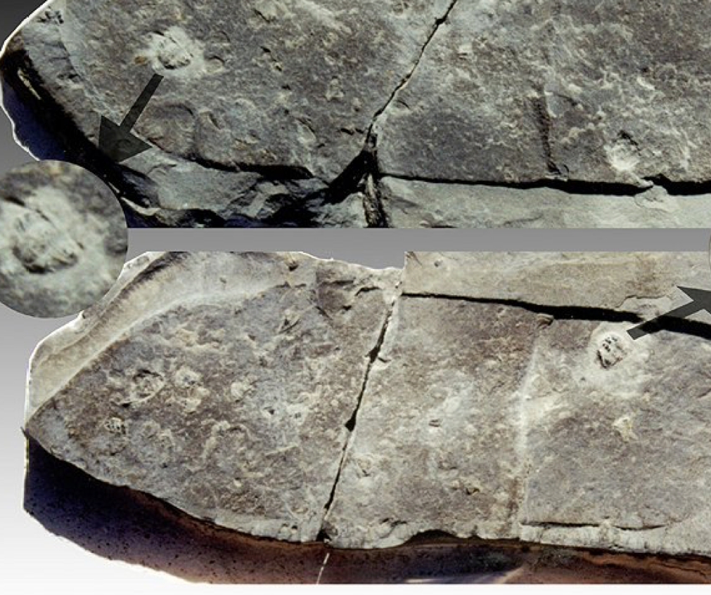
Proof that the Bible is the Word of God!
External Considerations – Creation
Some quick facts that support creation
Fact 1: Fossilized dinosaur and human footprints in same rock strata in the bed of the Paluxy River in Texas
Fact 2: Fossilized sandal print with crushed trilobites in it
The Bible predicts that we would find these fossils in the same strata, while evolution would say “impossible”

Slide 15
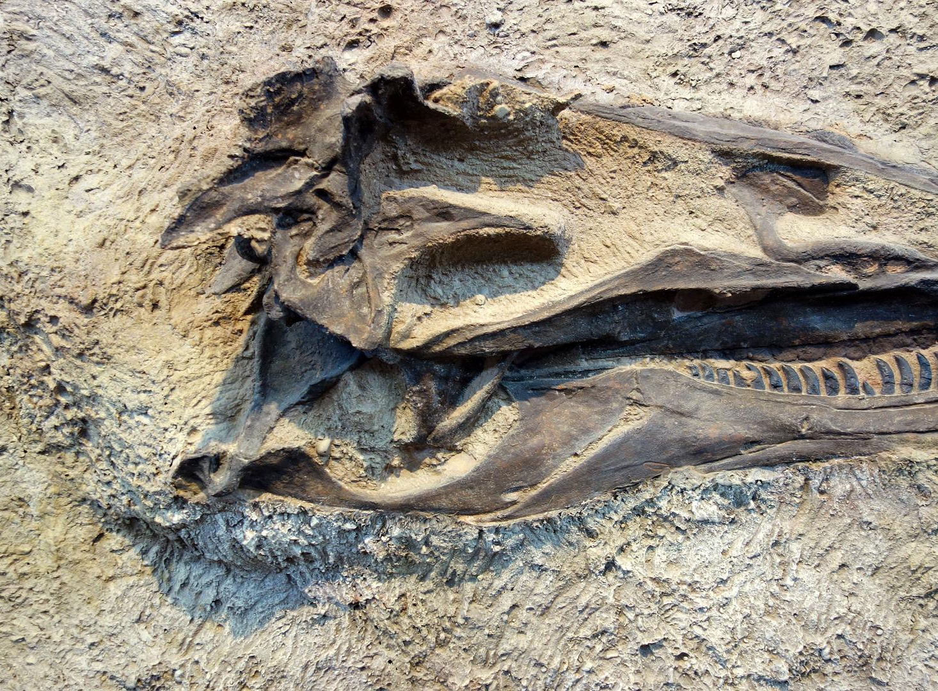
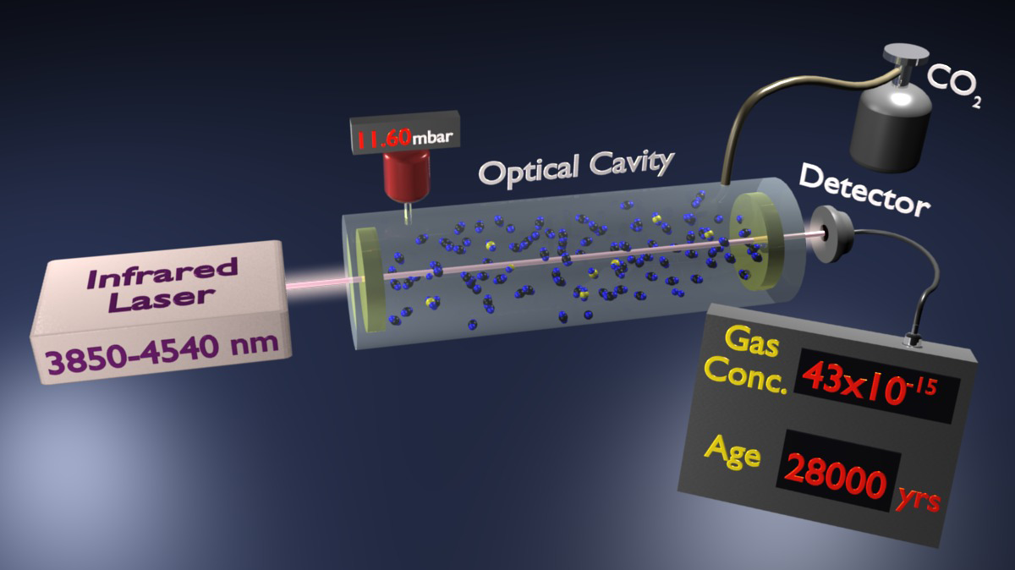
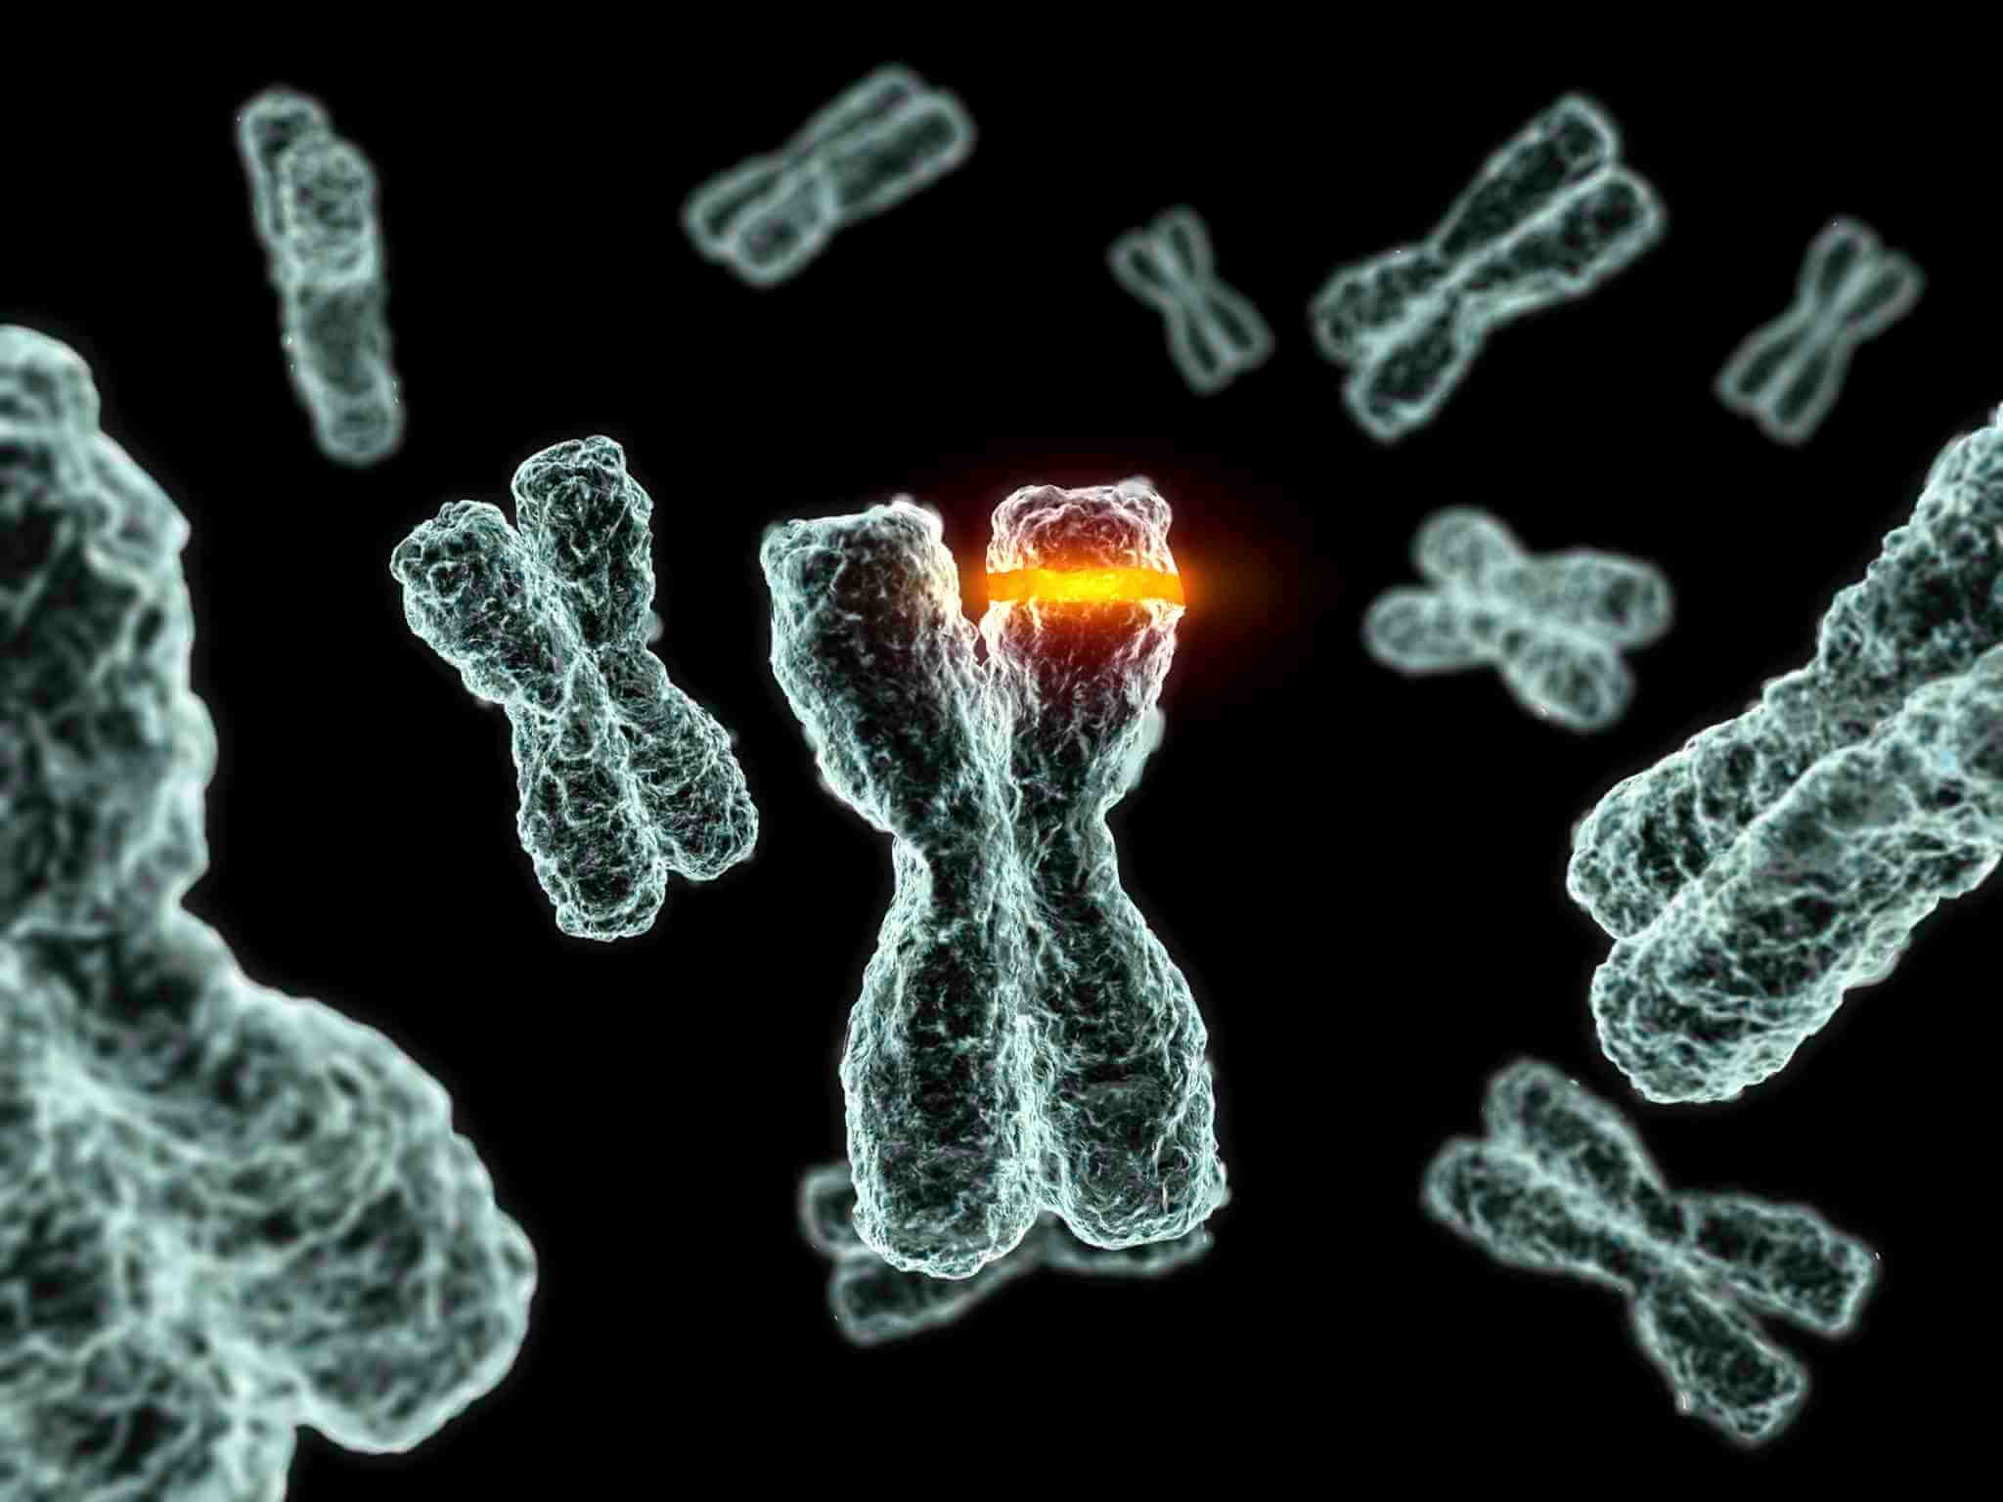
Proof that the Bible is the Word of God!
External Considerations – Creation
A few other key points
Unreliability of radioactive dating
Circular reasoning of dating rocks by kinds of fossils and vice versa
Mutation is always harmful rather than helpful
Impossible odds – even a simple cell could not have been formed by random action in 30 billion years
2nd Law of Thermodynamics states that everything is tending toward decay
Soft tissue found in dinosaur fossils

Slide 16
Proof that the Bible is the Word of God!
External Considerations – Creation
Evolution does not invalidate the Bible
The facts of natural science and the fossil record verify the Biblical account and refute evolution

Slide 17
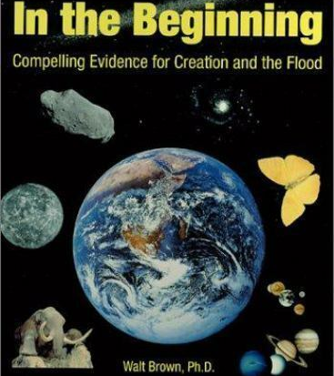
Proof that the Bible is the Word of God!
External Considerations – Creation
Additional Creation Resources
Illustra Media
Where Does The Evidence Lead?
Origins
Evolution’s Achilles’ Heels
In The Beginning
www.answersingenesis.org
www.icr.org

Slide 18
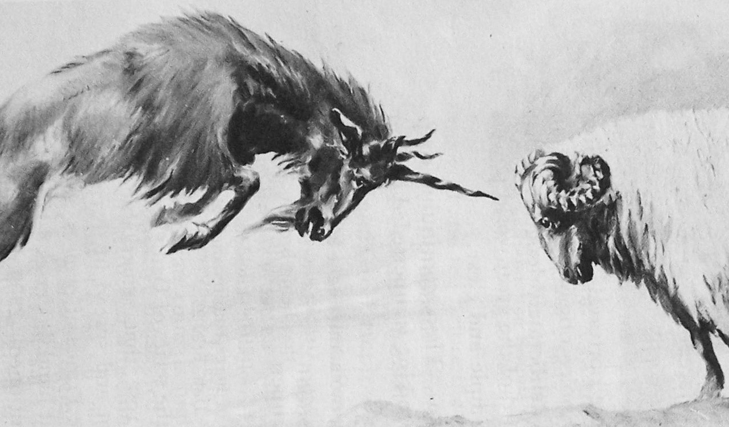
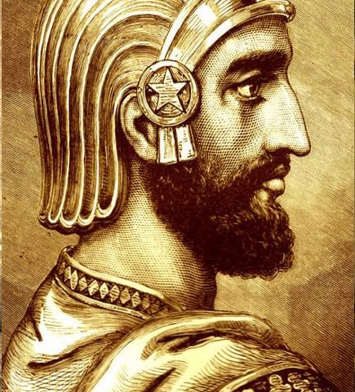
Proof that the Bible is the Word of God!
Part 3 – Fulfilled Historical Prophecy

